Slide 1
8051 TIMERS AND COUNTERS

Slide 2
Introduction
The 8051 CPU has a cycle time of 12 clock cycles per byte fetch. The 8051's clock source is an external crystal oscillator.
The 8051 provides two 16-bit timers/counters:
Timer 0 and Timer 1. These versatile timers can be configured to operate in four distinct modes, each serving specific timing requirements.
The 8051 has two timers/counters, Timer 0 and Timer 1. They can be used as either timers to generate a time delay or as counters to count events happening outside the microcontroller.
Both Timer 0 and Timer 1 are 16 bits wide. They are accessed as two separate registers of low byte and high byte.

Slide 3
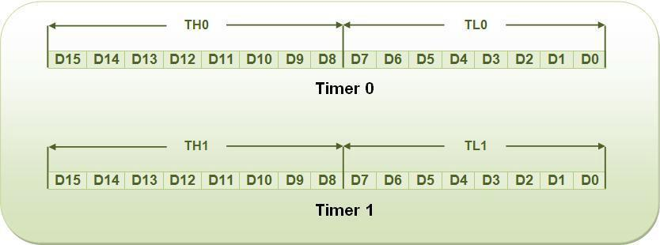
Timer 0 (T0) Register:
Low byte register of T0 is called TL0 and high byte is called as TH0.
These registers can be accessed like any other register.
For example, MOV TL0, #3EH, will transfer data 3EH to TL0, and
MOV A, TH0 will transfer content of TH0 to accumulator.
Timer 1 (T1) Register:
Low byte register of T1 is called TL1 and high byte is called as TH1. These registers are accessible in the same way as registers of Timer 0.

Slide 4
Timer related SFRs in 8051
SFR Address
TH0 Timer0 High Byte 8Ch
TL0 Timer0 Low Byte 8Ah
TH1 Timer1 High Byte 8Dh
TL1 Timer1 Low Byte 8Bh
TCON Timer Control 88h
TMOD Timer Mode 89h

Slide 5
C/T (clock/timer):
This bit is used to select timer hardware as a timer or counter. If this bit is set to 0, timer hardware act as a timer to generate time delay by counting internal clock pulse generated by the crystal oscillator. If the bit is set to 1, the hardware acts as a counter to count external clock pulse which represents an event.
Timer in 8051 is used as timer, counter and baud rate generator. Timer always counts up irrespective of whether it is used as timer, counter, or baud rate generator: Timer is always incremented by the microcontroller. The time taken to count one digit up is based on master clock frequency.
If Master CLK=11.0592 MHz,
Timer Clock frequency = Master CLK/12 = 921.6 kHz
Timer Clock Period = 1.085 micro second
This indicates that one increment in count will take 1.085 micro second.
The two timers in 8051 share two SFRs (TMOD and TCON) which control the timers, and each timer also has two SFRs dedicated solely to itself (TH0/TL0 and TH1/TL1)

Slide 6
CPU Timing in 8051 Microcontroller
CPU timing in the 8051 microcontroller refers to the way the processor executes instructions based on clock cycles. The timing is crucial in determining how fast instructions are executed and how peripherals interact with the CPU.
he 8051 microcontroller is driven by an external clock signal, typically 12 MHz.
The 8051 CPU uses this clock to execute instructions.
One machine cycle consists of 12 clock pulses (cycles).
The machine cycle is the basic unit of time for executing instructions.
Machine Cycle Formula:
Machine Cycle Time=Clock Period12\text{Machine Cycle Time} = \frac{\text{Clock Period}}{12}Machine Cycle Time=12Clock Period​ For example, with a 12 MHz clock:
Machine Cycle Time=112 MHz=1 µs\text{Machine Cycle Time} = \frac{1}{12 \text{ MHz}} = 1 \text{ µs}Machine Cycle Time=12 MHz1​=1 µs

Slide 7
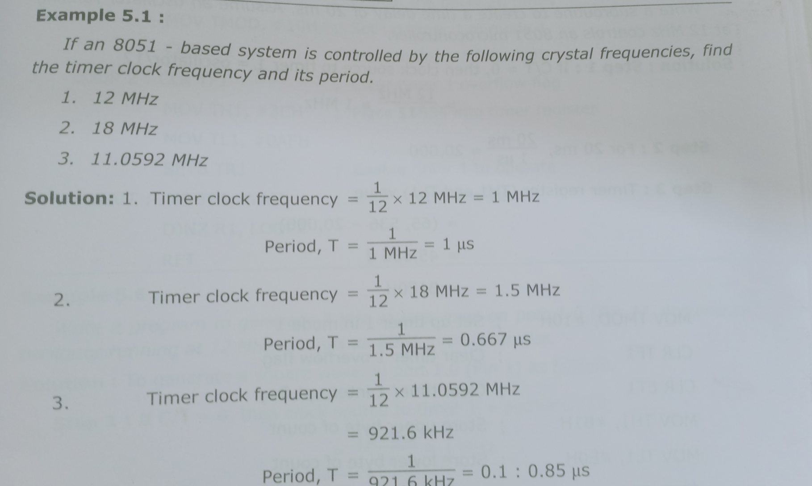

Slide 8
Each instruction in 8051 takes a specific number of machine cycles. Instructions can be classified as follows
Instruction Type | Example | Machine Cycles | Time at 12MHz (µs)
1-byte (Fastest) | NOP | 1 | 1 µs
2-byte (Medium) | MOV A, #05H | 1 | 1 µs
3-byte (Slowest) | LJMP 2000H | 2 | 2 us

Slide 9
TCON Register Format (Bit Structure)
)
Bit | Bit Name | Function | 0 = OFF / 1 = ON
7 | TF1 | Timer 1 Overflow Flag | 1 → Timer 1 Overflow
6 | TR1 | Timer 1 Run Control | 1 → Start Timer 1
5 | TF0 | Timer 0 Overflow Flag | 1 → Timer 0 Overflow
4 | TR0 | Timer 0 Run Control | 1 → Start Timer 0
3 | IE1 | External Interrupt 1 Flag | 1 → Interrupt Occurred
2 | IT1 | External Interrupt 1 Type | 1 → Edge, 0 → Level
1 | IE0 | External Interrupt 0 Flag | 1 → Interrupt Occurred
0 | IT0 | External Interrupt 0 Type | 1 → Edge, 0 → Level

Slide 10
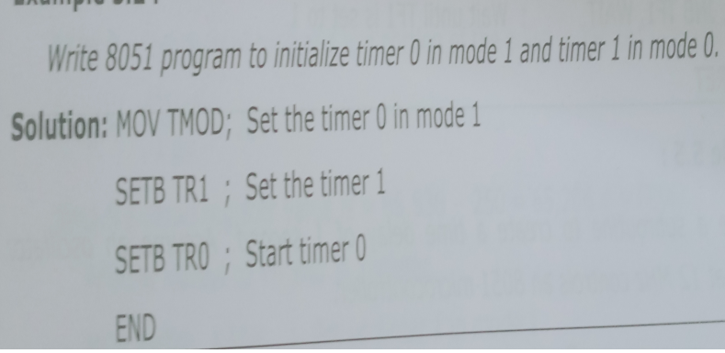
For Eg. Start Timer 0 in Mode 1
SETB TR0 ; Start Timer 0
CLR TR0 ; Stop Timer 0

Slide 11
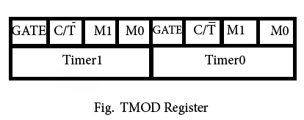
TMOD
M0 | M1 | Mode | Operating Mode
0 | 0 | Mode 0 | 13-bit timer mode, 8-bit timer/counter THx and TLx as 5-bit prescalar.
0 | 1 | Mode 1 | 16-bit timer mode, 16-bit timer/counters THx and TLx are cascaded; There are no prescalar.
1 | 0 | Mode 2 | 8-bit auto reload mode, 8-bit auto reload timer/counter; THx holds a value which is to be reloaded into TLx each
1 | 1 | Mode 3 | Spilt timer mode.

Slide 12
Programming the 8051 Timers
1.Generating a Delay using Timer Mode 1 (16-bit mode)
MOV TMOD, #01H ; Select Timer 0, Mode 1 (16-bit)
MOV TH0, #0xFC ; Load high byte
MOV TL0, #0x66 ; Load low byte (for 1ms delay)
SETB TR0 ; Start Timer 0
HERE: JNB TF0, HERE; Wait until overflow (TF0 = 1)
CLR TR0 ; Stop Timer
CLR TF0 ; Clear overflow flag

Slide 13
2. Using Timer in Mode 2 (8-bit auto-reload)
MOV TMOD, #20H ; Select Timer 1, Mode2 MOV TH1, #0xFD ; Load auto-reload value
MOV TL1, #0xFD ; Load initial value
SETB TR1 ; Start Timer 1
HERE: JNB TF1, HERE; Wait for overflow
CLR TF1 ; Clear overflow flag

Slide 14
3.Using Timer as an Event Counter
MOV TMOD, #05H ; Select Timer 0 as Counter, Mode 1
SETB TR0 ; Start Counter
HERE: JNB TF0, HERE; Wait for event count overflow
CLR TF0 ; Clear overflow flag

Slide 15
4.Mode 3 – Split Timer Mode
In Mode 3, Timer 0 is split into two independent 8-bit timers.
Timer 1 loses functionality in this mode and cannot be used.
How Mode 3 Works:
TL0 (Lower 8-bit timer) operates as a full 8-bit timer with its own control.
TH0 (Higher 8-bit timer) acts as another independent 8-bit timer.
Timer 1 remains inactive and cannot be used.
Setting Timer 0 in Mode 3:
TL0 is controlled by TR0 and TF0.
TH0 is controlled by TR1 and TF1 (Yes, TR1 and TF1, even though it is Timer 0).

Slide 16
Example Code for Split Timer Mode
MOV TMOD, #04H ; Set Timer 0 to Mode 3
MOV TH0, #0FFH ; Load TH0 (upper 8-bit timer)
MOV TL0, #0A0H ; Load TL0 (lower 8-bit timer)
SETB TR0 ; Start lower timer
SETB TR1 ; Start upper timer
HERE: JNB TF0, HERE ; Wait for TL0 overflow
CLR TF0 ; Clear overflow flag

Slide 17
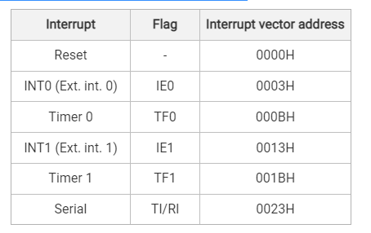
Interrupt structure
The 8051 microcontroller has a built-in interrupt structure that allows it to respond quickly to external and internal events. The 8051 supports five interrupts, including hardware and software interrupts.

Slide 18
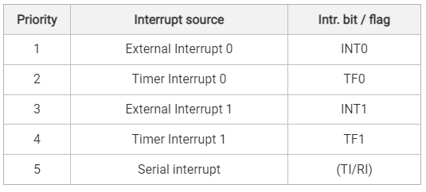
8051 Interrupt priority

